Slide 1



Brookhaven Hospital
Patient Readmissions
PowerFul4

Slide 2

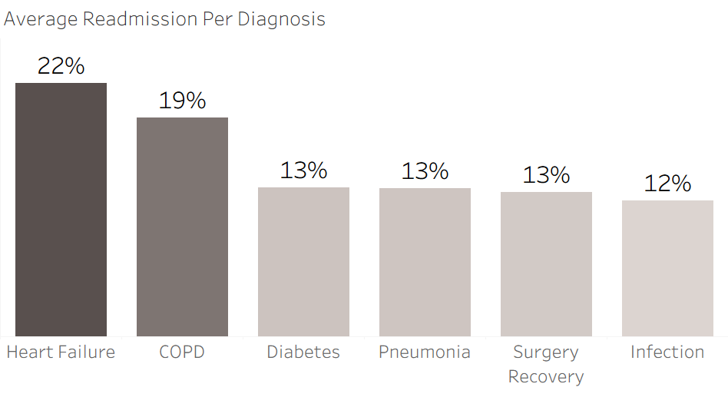
Who is at risk?
Heart Failure and COPD patients have high readmission rates.
Notes:
Miles:
To find out who is at the most risk of readmission,
We started by looking at the types of diagnoses being treated at Brookhaven.
After some investigation, it is clear that
Heart Failure and COPD patients were readmitted at significantly higher rates than other types of patients.
Based on this,
We created a model to analyze the impact of certain hospital recommendations on these patient’s outcomes.

Slide 3


Short Term
The Numbers
Next Steps
Effect on readmission rate when a follow up is scheduled
Required follow-ups for COPD and Heart Failure patients
25%
in Heart Failure patients
24.5%
in COPD patients

Slide 4

Long Term
The Numbers
Next Steps
⅓
of COPD / heart failure patients are recommended at home health care plans
Notes:
Incentivized group care plan - Brookhaven Hospital
Support group for COPD and Heart Failure patients
Led by nurse care manager, respiratory therapist, dietitian
Lifestyle changes encouraged, medication routines managed, community formed
Weekly meetings
Focus areas: lifestyle and exercise, nutrition: low sodium and inflammatory diet . reading food labels, hydration
medication management: understanding inhalers, beta blockers, creation of routines
symptom awareness: weight tracking, recognizing flare ups
mental health through peer support
invite caregivers to join group

